Slide 1
Title: Monster Game
By: A. Krishna Chaitanya(737-308)
Anthati Karthik(737-310)

Slide 2
Abstract
The goal of this project is to provide some fun time to the user. The main task in this game is to save the player(human) from the monster. User should use the arrow keys to move the human(up arrow to jump,left arrow to move left and right arrow to move right). As you progress the speed of monster increases gradually. If your caught by the monster then the final score appears on the screen. Here users can compete with each other by comparing their respective scores which are displayed in the leaderboard.

Slide 3
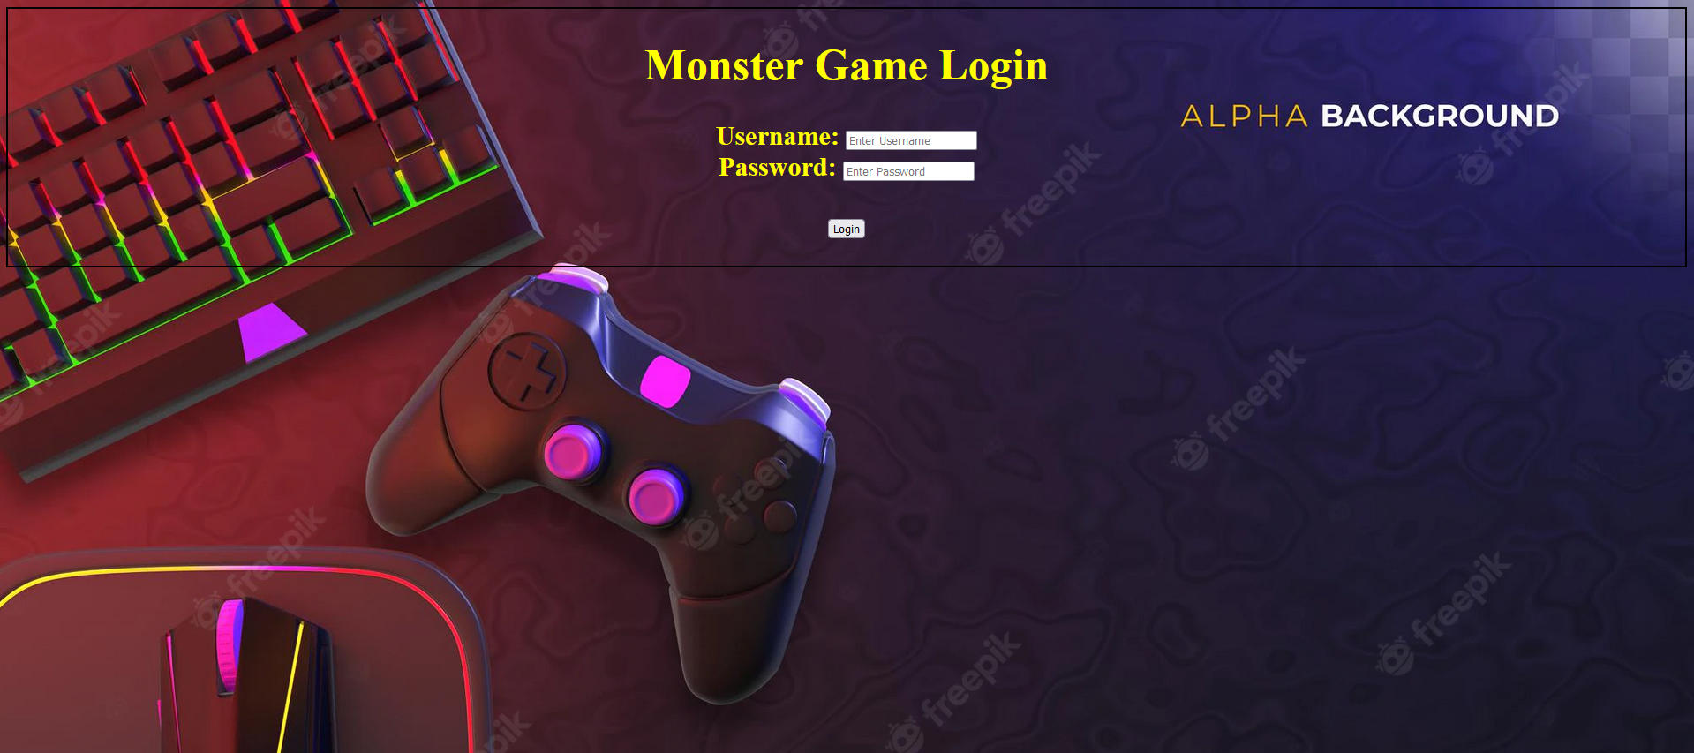
Login Page

Slide 4
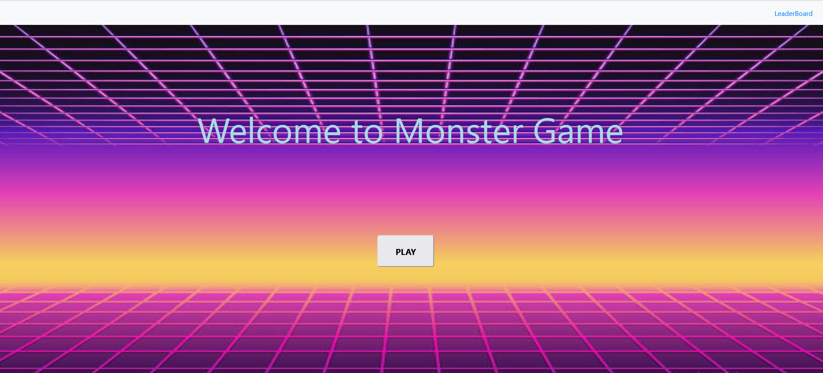
Home Page

Slide 5
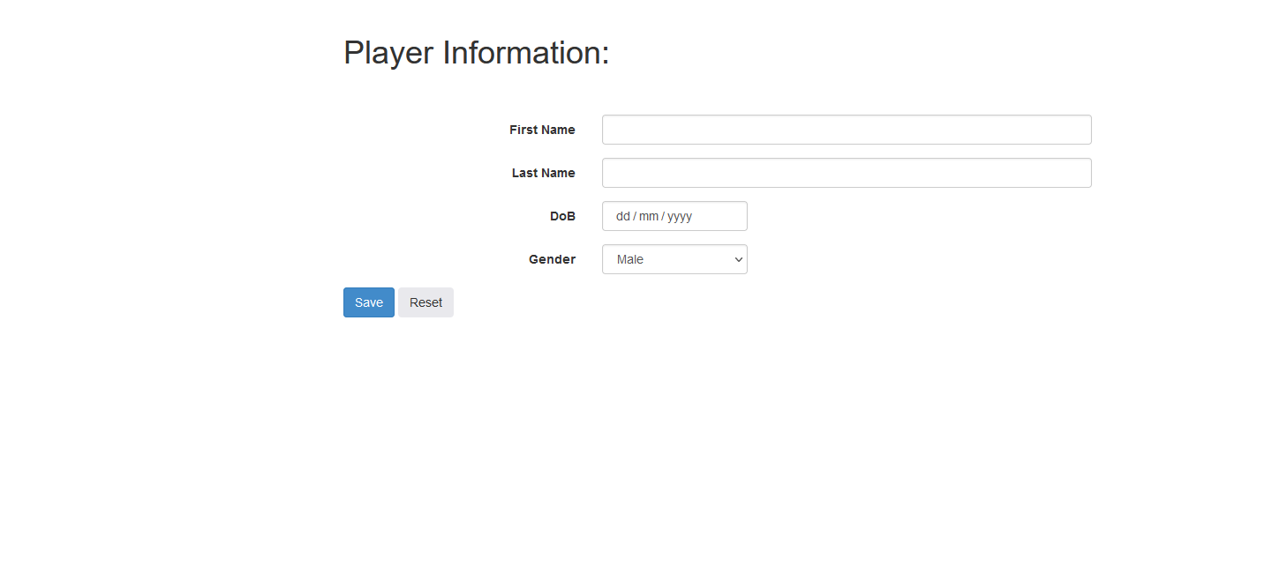
Player Information

Slide 6
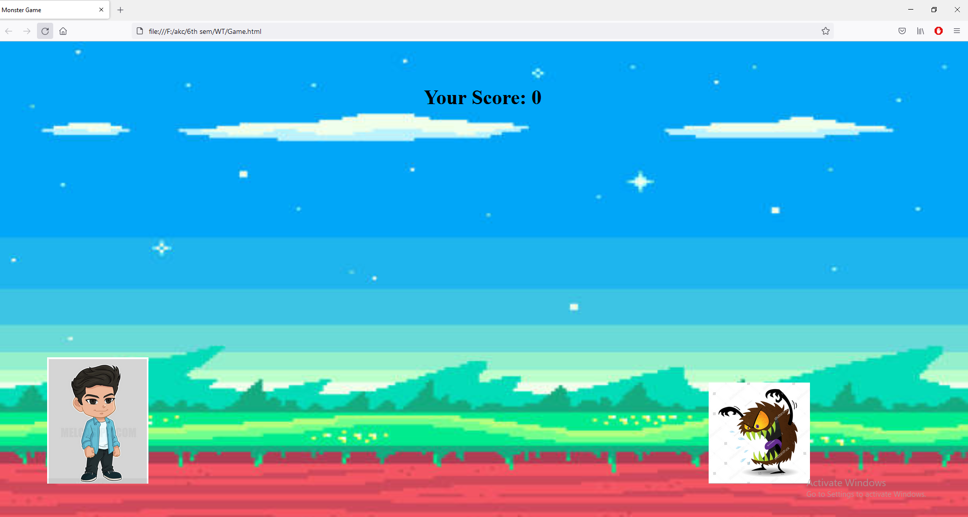
When ever the monster comes user needs to jump(using arrow key up) and move right(using arrow key right) .

Slide 7
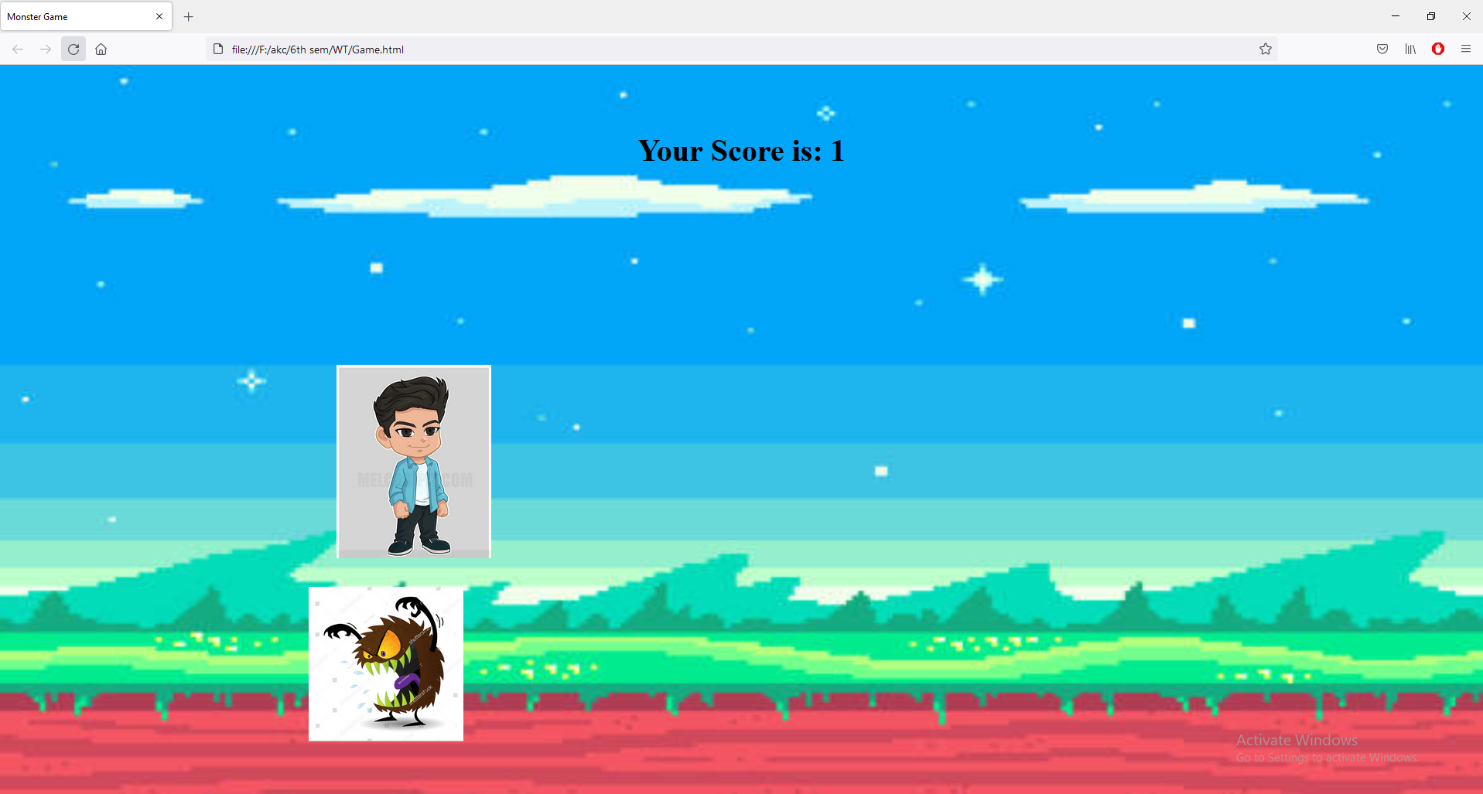

Slide 8
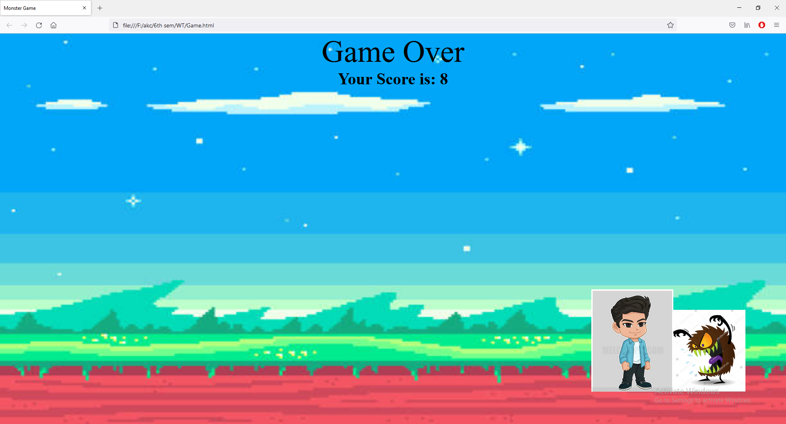
If the monster catches the user then game ends.

Slide 9
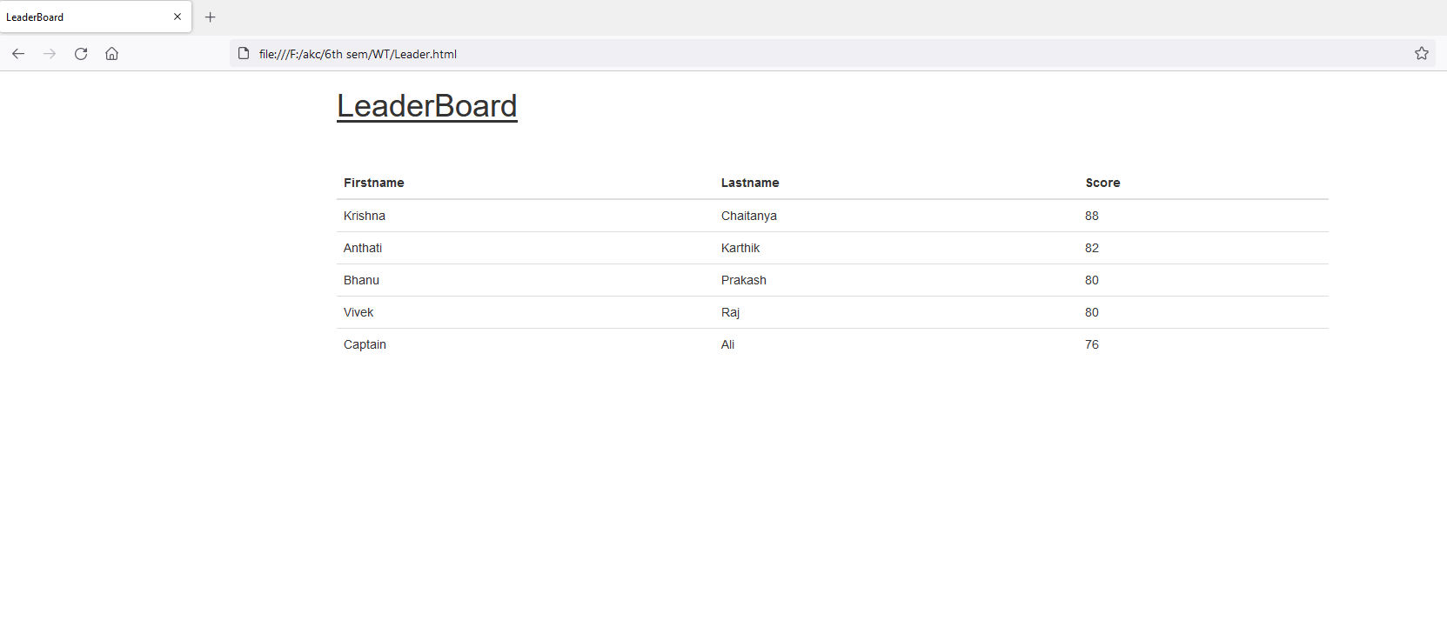
LeaderBoard

